Slide 1
OOP PRESENTATION
HODONG PARK, JUNGHOON PARK,
DONGGEON LEE, MINHYEOK JANG

Slide 2
CONTENTS
1. Introduction to Topic
2. Design Focus
3. UML Design
2-1. Activity Diagram
2-2. Class Diagram
2-3. Use Case Diagram
4. Execution Demo
5. Concluding Remark

Slide 3
01
Introduction to Topic

Slide 4
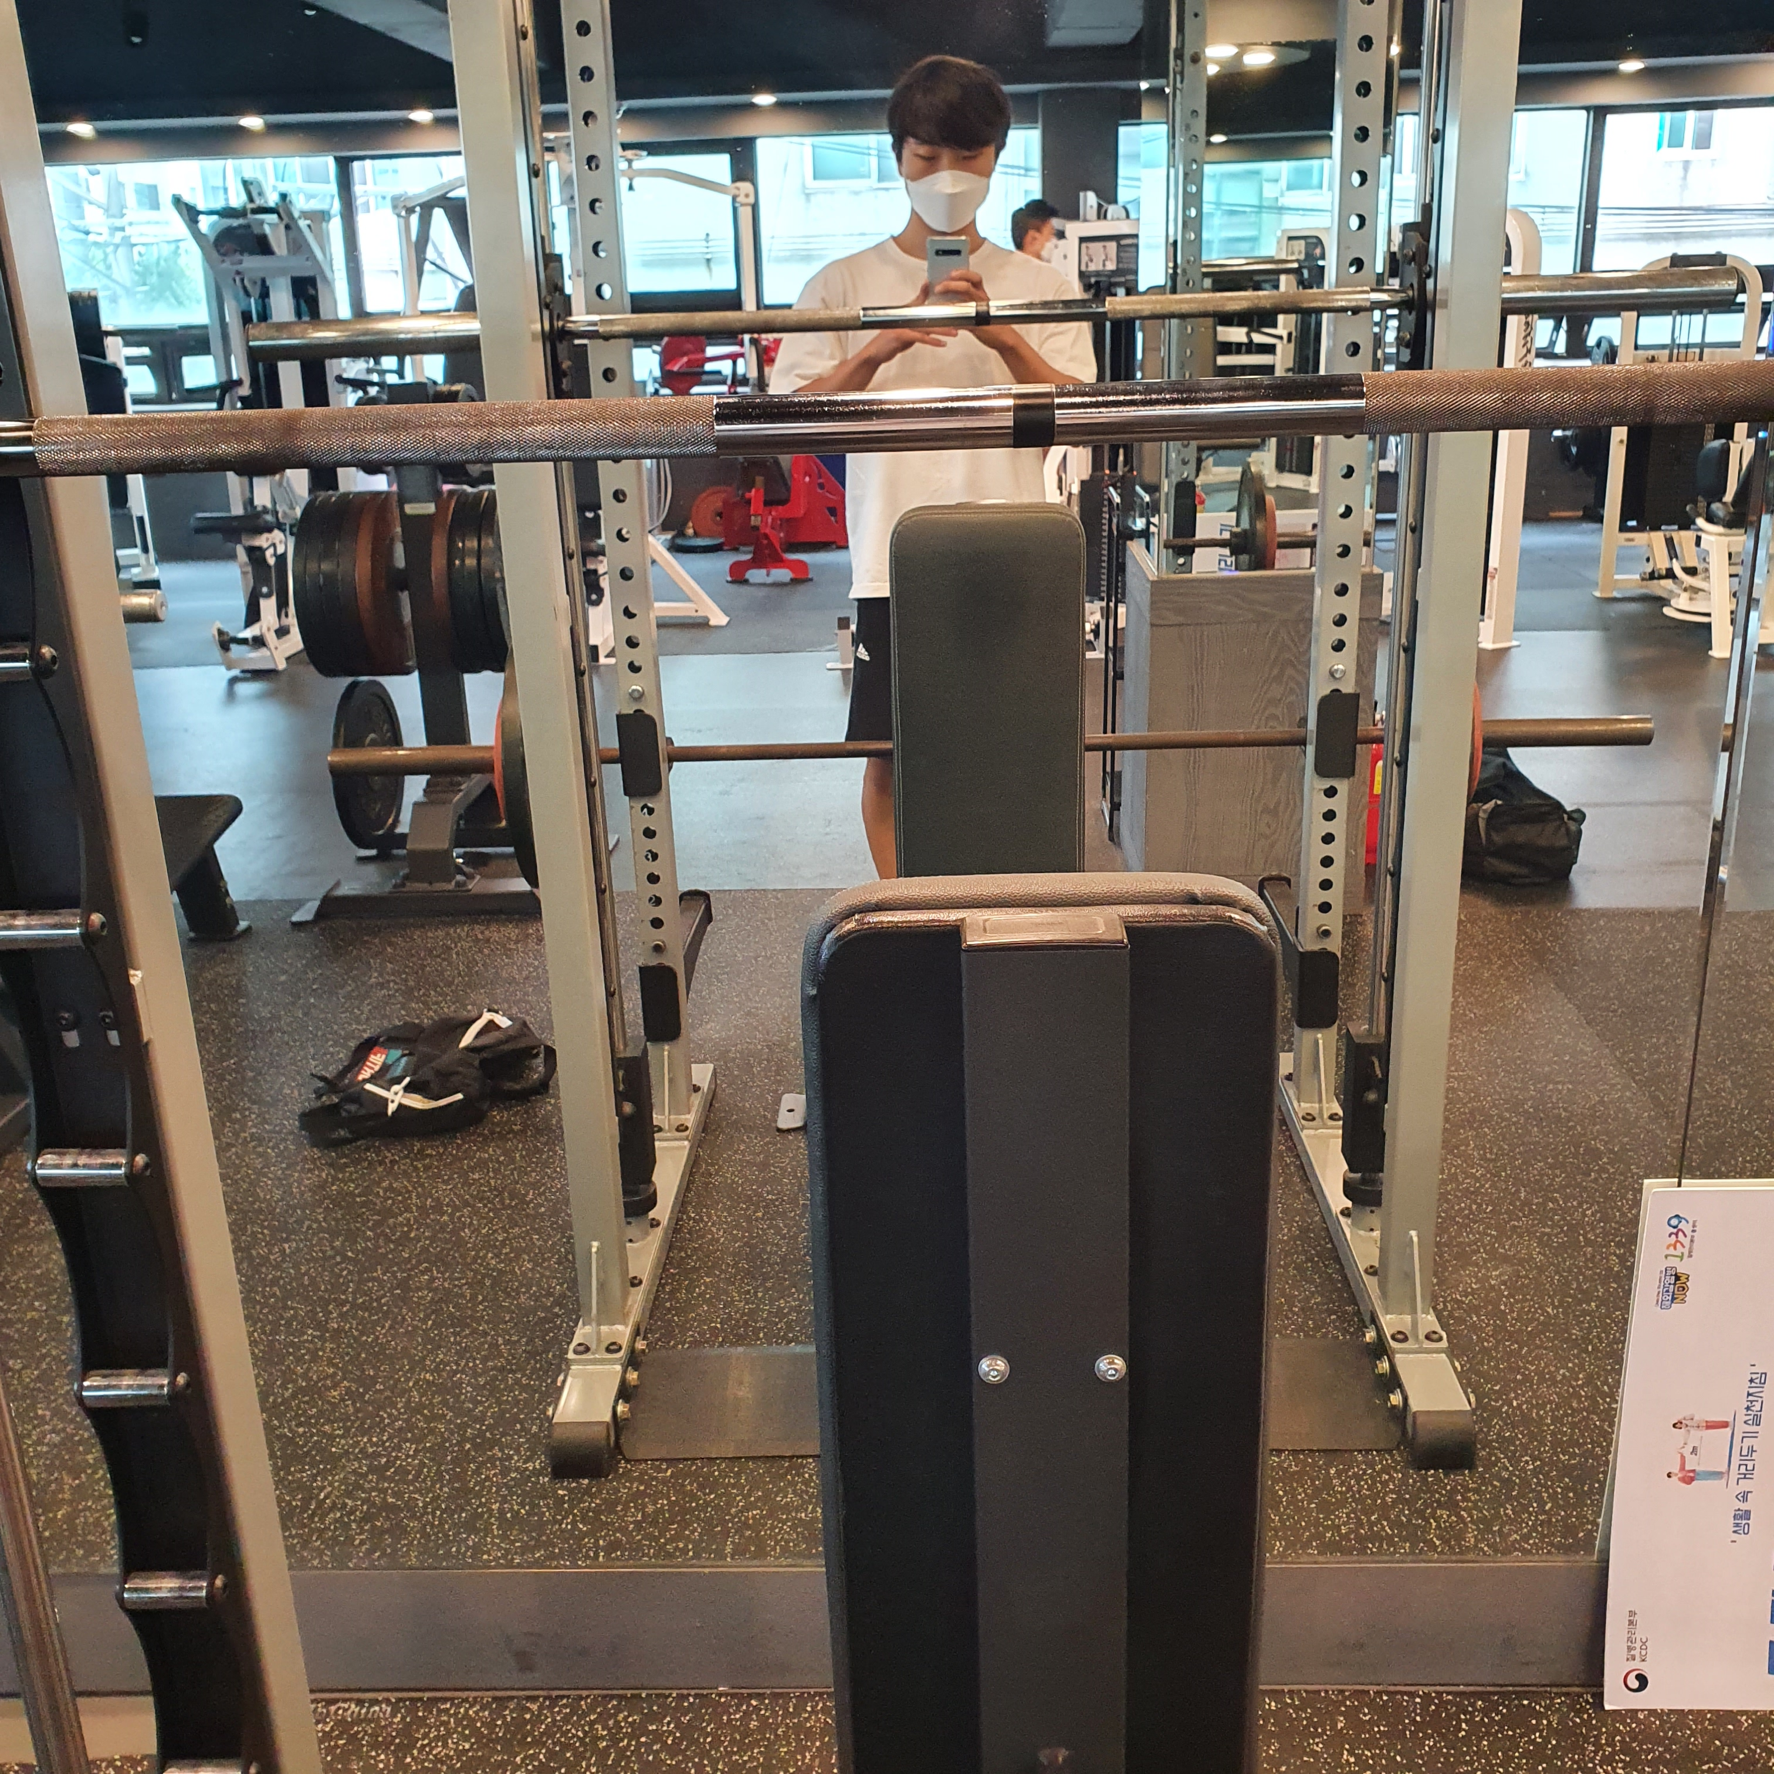
Exercise Diary
Records make your body
Our app helps everyone who likes exercise from home training to the gym to easily plan exercise and intuitively record exercise to check for improved results.

Slide 5
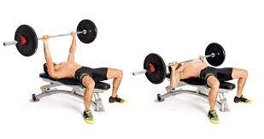
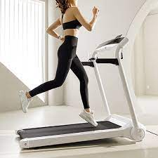
Set: 5 Reps: 10 Weight: 50kg
Time: 00:31:22

Slide 6
02
Design Focus

Slide 7
Software Structure
Data Management
We focus on make functions work independent
We can upgrade program without touching other parts of program
Algorithm
UI

Slide 8
03
UML Design

Slide 9
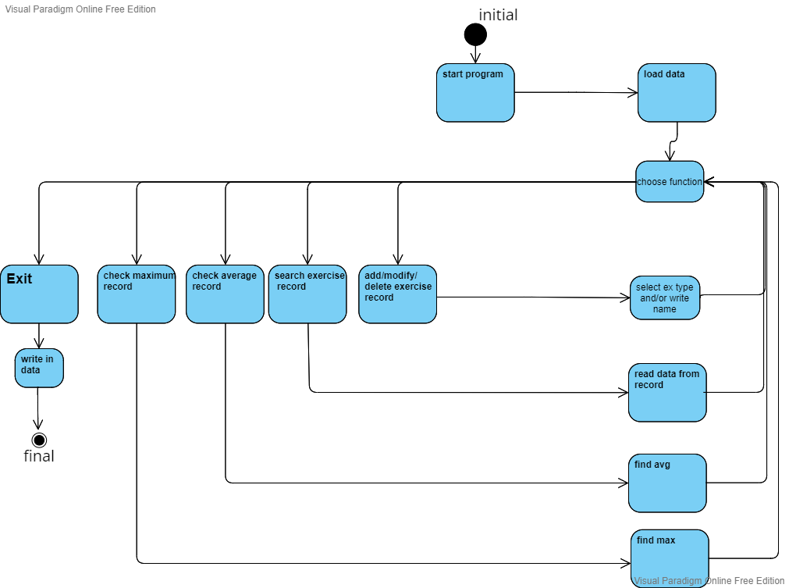
Activity Diagram

Slide 10
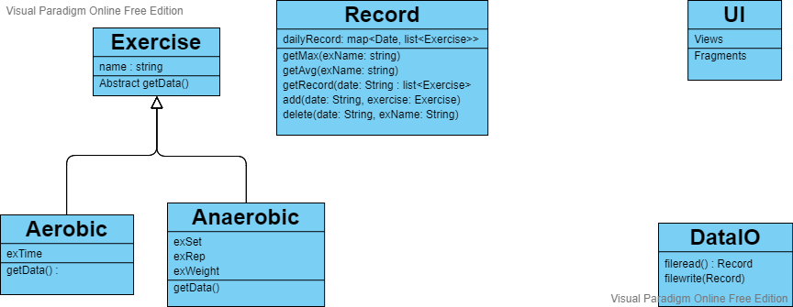
Class Diagram

Slide 11
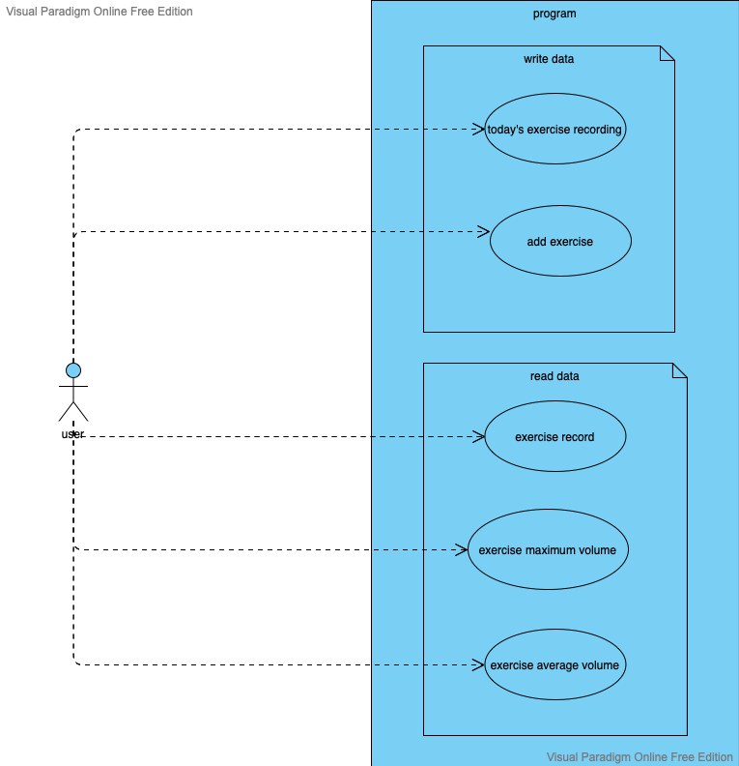
Use Case Diagram

Slide 12
04
Execution Demo

Slide 13
05
Concluding Remark

Slide 14
THANKS

